Slide 1
Chapter 4 – Requirements Engineering
Instructor
Dr. Sultan S. Alqahtani
ssalqahtani@imamu.edu.sa
Note: These are a slightly modified version of Ch4 slides available from the author’s site http://www.cs.st-andrews.ac.uk/~ifs/Books/SE9/

Slide 2
Before we start
Agile development methods
XP vs. Scrum
Agile Scaling up and out.

Slide 3
Topics covered
Functional and non-functional requirements
The software requirements document
Requirements specification
Requirements engineering processes
Requirements elicitation and analysis
Requirements validation
Requirements management

Slide 4
Requirements engineering
What is requirement
What is requirement engineering
The requirements themselves are the descriptions of the system services and constraints that are generated during the requirements engineering process.
The process of establishing the services that the customer requires from a system and the constraints under which it operates and is developed.

Slide 5
What is a requirement?
It may range from a high-level abstract statement of a service or of a system constraint to a detailed mathematical functional specification.
This is inevitable as requirements may serve a dual function
May be the basis for a bid for a contract - therefore must be open to interpretation;
May be the basis for the contract itself - therefore must be defined in detail;
Both these statements may be called requirements.

Slide 6
Types of requirements
User requirements
Statements in natural language plus diagrams of the services the system provides and its operational constraints. Written for customers.
System requirements
A structured document setting out detailed descriptions of the system’s functions, services and operational constraints. Defines what should be implemented so may be part of a contract between client and contractor.

Slide 7
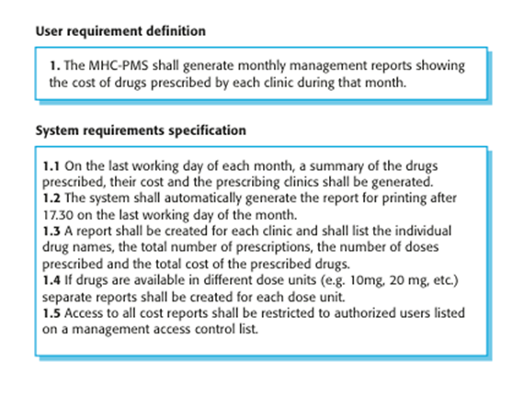
User and system requirements

Slide 8
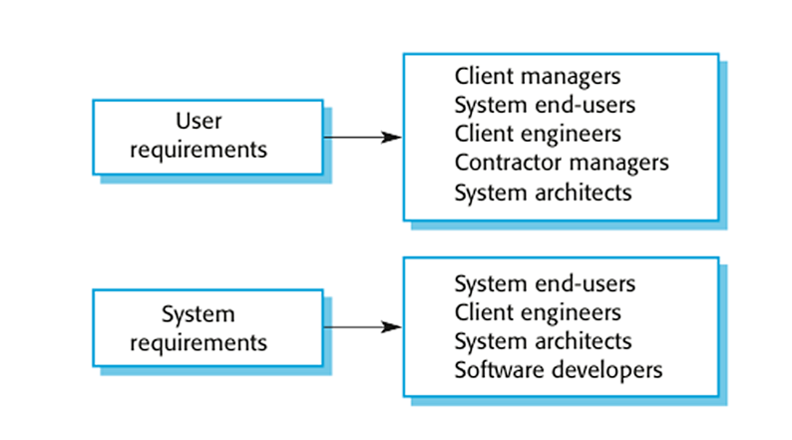
Readers of different types of requirements specification

Slide 9
Functional and non-functional requirements
Functional requirements
Statements of services the system should provide, how the system should react to particular inputs and how the system should behave in particular situations.
May state what the system should not do.
Non-functional requirements
Constraints on the services or functions offered by the system such as timing constraints, constraints on the development process, standards, etc.
Often apply to the system as a whole rather than individual features or services.

Slide 10
Functional vs. non-functional requirements
A functional requirement describes what a software system should do, while non-functional requirements place constraints on how the system will do so.
An example of a functional requirement would be:
A system must send an email whenever a certain condition is met (e.g. an order is placed, a customer signs up, etc).
A related non-functional requirement for the system may be:
Emails should be sent with a latency of no greater than 12 hours from such an activity.

Slide 11
Functional requirements
Describe functionality or system services.
Depend on the type of software, expected users and the type of system where the software is used.
Functional user requirements may be high-level statements of what the system should do.
Functional system requirements should describe the system services in detail.

Slide 12
Functional requirements for the MHC-PMS
A user shall be able to search the appointments lists for all clinics.
The system shall generate each day, for each clinic, a list of patients who are expected to attend appointments that day.
Each staff member using the system shall be uniquely identified by his or her 8-digit employee number.
Notes:
A patient information system for mental health care

Slide 13

Requirements imprecision
Problems arise when requirements are not precisely stated.
Ambiguous requirements may be interpreted in different ways by developers and users.
Consider the term ‘search’ in requirement 1
User intention – search for a patient name across all appointments in all clinics;
Developer interpretation – search for a patient name in an individual clinic. User chooses clinic then search.

Slide 14
Requirements completeness and consistency
In principle, requirements should be both complete and consistent.
Complete
They should include descriptions of all facilities required.
Consistent
There should be no conflicts or contradictions in the descriptions of the system facilities.
In practice, it is impossible to produce a complete and consistent requirements document.

Slide 15
Non-functional requirements
These define system properties and constraints e.g. reliability, response time and storage requirements. Constraints are I/O device capability, system representations, etc.
Non-functional requirements may be more critical than functional requirements. If these are not met, the system may be useless.

Slide 16
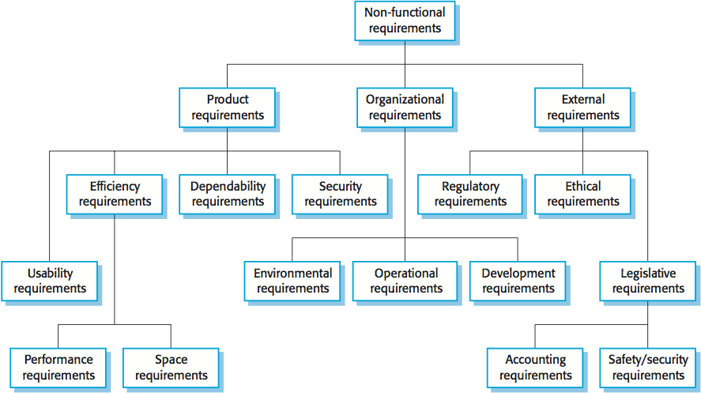
Types of nonfunctional requirement

Slide 17
Non-functional classifications
Product requirements
Requirements which specify that the delivered product must behave in a particular way e.g. execution speed, reliability, etc.
Organisational requirements
Requirements which are a consequence of organisational policies and procedures e.g. process standards used, implementation requirements, etc.
External requirements
Requirements which arise from factors which are external to the system and its development process e.g. interoperability requirements, lawmaking requirements, etc.

Slide 18
Examples of nonfunctional requirements in the MHC-PMS
Product requirement The MHC-PMS shall be available to all clinics during normal working hours (Mon–Fri, 0830–17.30). Downtime within normal working hours shall not exceed five seconds in any one day. Organizational requirement Users of the MHC-PMS system shall authenticate themselves using their health authority identity card. External requirement The system shall implement patient privacy provisions as set out in HStan-03-2006-priv.

Slide 19
Non-functional requirements implementation
Non-functional requirements may affect the overall architecture of a system rather than the individual components.
For example, to ensure that performance requirements are met, you may have to organize the system to minimize communications between components.
A single non-functional requirement, such as a security requirement, may generate a number of related functional requirements that define system services that are required.
It may also generate requirements that restrict existing requirements.

Slide 20
Key points
Requirements for a software system set out what the system should do and define constraints on its operation and implementation.
Functional requirements are statements of the services that the system must provide or are descriptions of how some computations must be carried out.
Non-functional requirements often constrain the system being developed and the development process being used.
They often relate to the emergent properties of the system and therefore apply to the system as a whole.

Slide 21
Chapter 4 – Requirements Engineering
Part 2

Slide 22
The software requirements document
The software requirements document is the official statement of what is required of the system developers.
Should include both a definition of user requirements and a specification of the system requirements.
It is NOT a design document. As far as possible, it should set of WHAT the system should do rather than HOW it should do it.

Slide 23
Agile methods and requirements
Many agile methods argue that producing a requirements document is a waste of time as requirements change so quickly.
The document is therefore always out of date.
Methods such as XP use incremental requirements engineering and express requirements as ‘user stories’ (discussed in Chapter 3).
This is practical for business systems but problematic for systems that require a lot of pre-delivery analysis (e.g. critical systems) or systems developed by several teams.

Slide 24
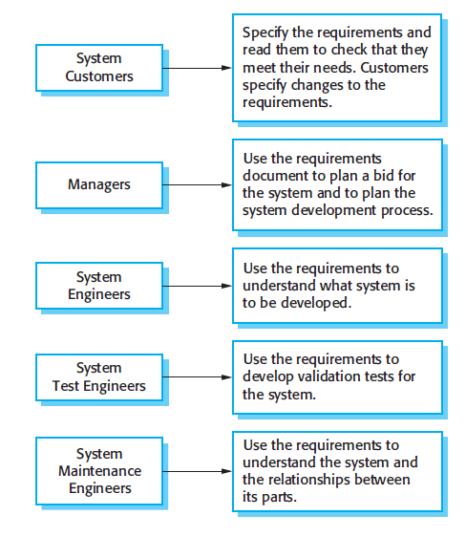
Users of a requirements document

Slide 25
Requirements document variability
Information in requirements document depends on type of system and the approach to development used.
Systems developed incrementally will, typically, have less detail in the requirements document.
Requirements documents standards have been designed e.g. IEEE standard. These are mostly applicable to the requirements for large systems engineering projects.

Slide 26
SRS slides

Slide 27
Requirements specification
The process of writing down the user and system requirements in a requirements document.
User requirements have to be understandable by end-users and customers who do not have a technical background.
System requirements are more detailed requirements and may include more technical information.
The requirements may be part of a contract for the system development
It is therefore important that these are as complete as possible.

Slide 28
Requirements and design
In principle, requirements should state what the system should do and the design should describe how it does this.
In practice, requirements and design are inseparable
A system architecture may be designed to structure the requirements;
The system may inter-operate with other systems that generate design requirements;
The use of a specific architecture to satisfy non-functional requirements may be a domain requirement.
This may be the consequence of a regulatory requirement.

Slide 29
Natural language specification
Requirements are written as natural language sentences supplemented by diagrams and tables.
Used for writing requirements because it is expressive, intuitive and universal. This means that the requirements can be understood by users and customers.

Slide 30
Example requirements for the insulin pump software system
3.2 The system shall measure the blood sugar and deliver insulin, if required, every 10 minutes. (Changes in blood sugar are relatively slow so more frequent measurement is unnecessary; less frequent measurement could lead to unnecessarily high sugar levels.) 3.6 The system shall run a self-test routine every minute with the conditions to be tested and the associated actions defined in Table 1. (A self-test routine can discover hardware and software problems and alert the user to the fact the normal operation may be impossible.)

Slide 31
Problems with natural language
Lack of clarity
Precision is difficult without making the document difficult to read.
Requirements confusion
Functional and non-functional requirements tend to be mixed-up.
Requirements amalgamation
Several different requirements may be expressed together.

Slide 32
What is the solutions
Structured specifications
Form based specifications
Tabular specifications

Slide 33
Structured specifications
An approach to writing requirements where the freedom of the requirements writer is limited and requirements are written in a standard way.
This works well for some types of requirements e.g. requirements for embedded control system but is sometimes too rigid for writing business system requirements.

Slide 34
Form-based specifications
Definition of the function or entity.
Description of inputs and where they come from.
Description of outputs and where they go to.
Information about the information needed for the computation and other entities used.
Description of the action to be taken.
Pre and post conditions (if appropriate).
The side effects (if any) of the function.

Slide 35
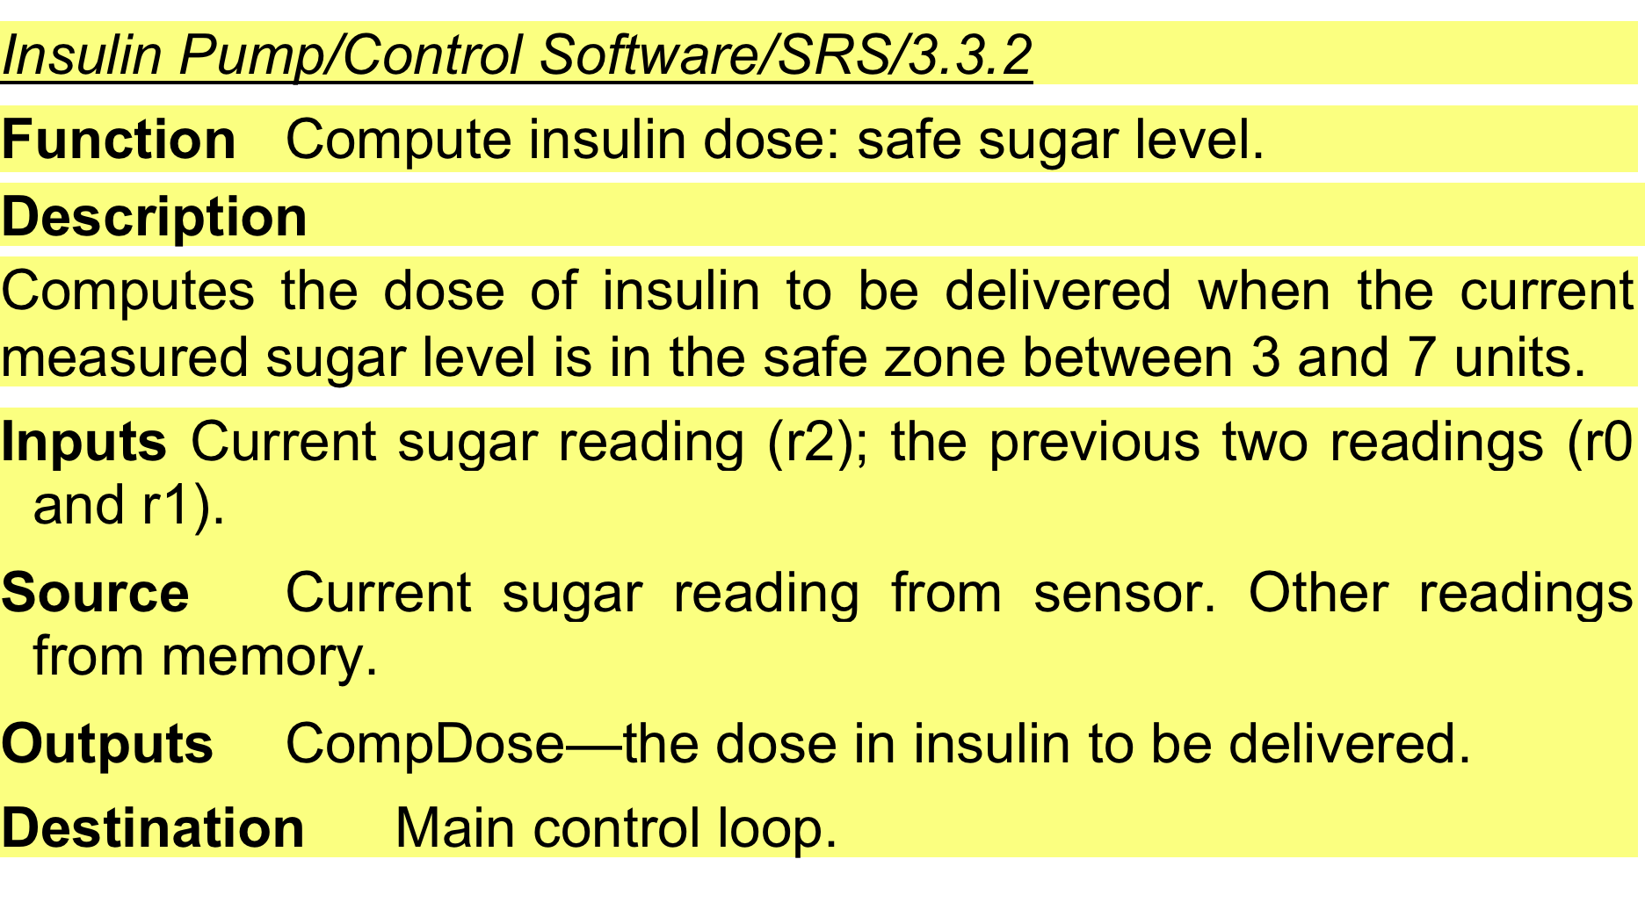
A structured specification of a requirement for an insulin pump

Slide 36
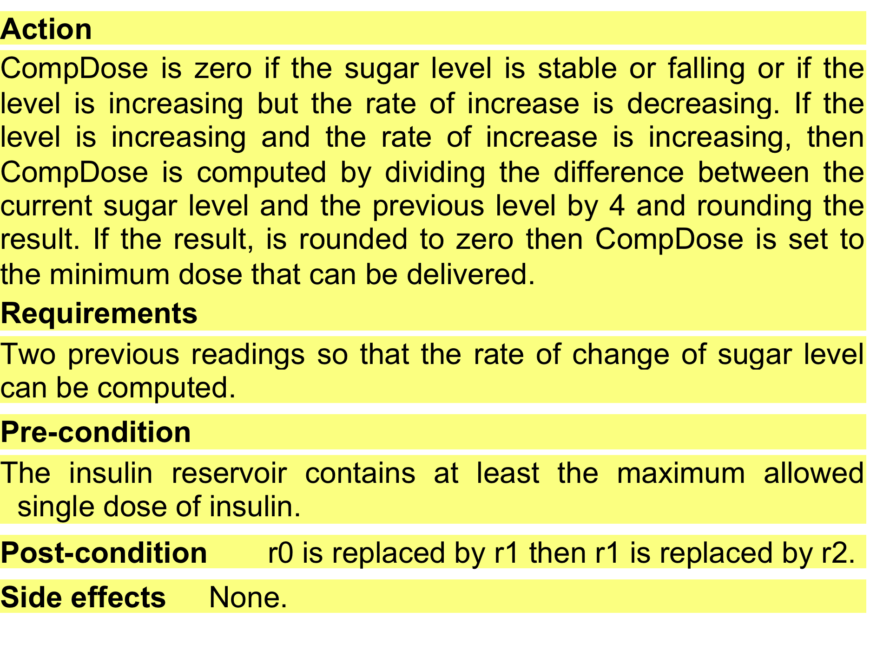
A structured specification of a requirement for an insulin pump

Slide 37
Tabular specification
Used to supplement natural language.
Particularly useful when you have to define a number of possible alternative courses of action.
For example, the insulin pump systems bases its computations on the rate of change of blood sugar level and the tabular specification explains how to calculate the insulin requirement for different scenarios.

Slide 38
Tabular specification of computation for an insulin pump
Condition | Action
Sugar level falling (r2 < r1) | CompDose = 0
Sugar level stable (r2 = r1) | CompDose = 0
Sugar level increasing and rate of increase decreasing ((r2 – r1) < (r1 – r0)) | CompDose = 0
Sugar level increasing and rate of increase stable or increasing ((r2 – r1) ≥ (r1 – r0)) | CompDose = round ((r2 – r1)/4) If rounded result = 0 then CompDose = MinimumDose

Slide 39
Requirements engineering processes
The processes used for RE vary widely depending on the application domain, the people involved and the organisation developing the requirements.
RE include four high-level activities (Chapter 2 slide 16).
However, there are a number of generic activities common to all processes
Requirements elicitation;
Requirements analysis;
Requirements validation;
Requirements management.
In practice, RE is an iterative activity in which these processes are interleaved.

Slide 40
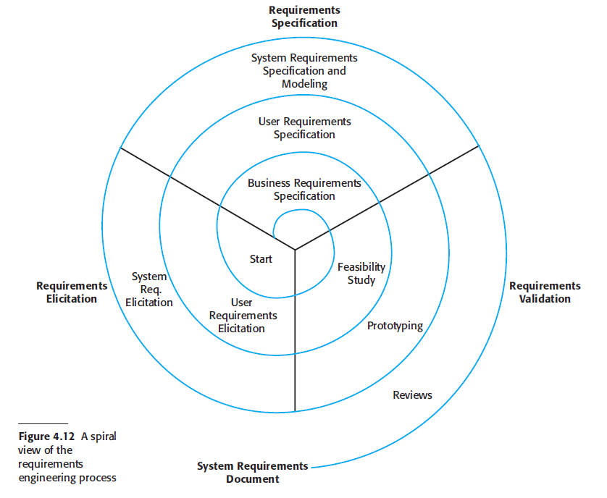
A spiral view of the requirements engineering process

Slide 41
Requirements elicitation and analysis
Sometimes called requirements elicitation or requirements discovery.
Involves technical staff working with customers to find out about the application domain, the services that the system should provide and the system’s operational constraints.
May involve end-users, managers, engineers involved in maintenance, domain experts, trade unions, etc. These are called stakeholders.

Slide 42
Requirements elicitation and analysis
Software engineers work with a range of system stakeholders to find out about the application domain, the services that the system should provide, the required system performance, hardware constraints, other systems, etc.
Stages include:
Requirements discovery,
Requirements classification and organization,
Requirements prioritization and negotiation,
Requirements specification.

Slide 43
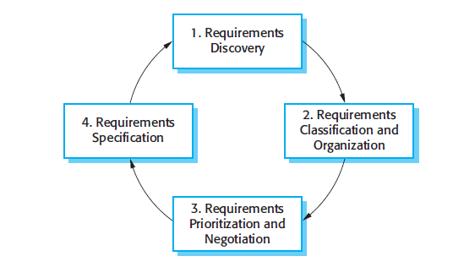
The requirements elicitation and analysis process

Slide 44
Process activities
Requirements discovery
Interacting with stakeholders to discover their requirements. Domain requirements are also discovered at this stage.
Requirements classification and organisation
Groups related requirements and organises them into coherent clusters.
Prioritisation and negotiation
Prioritising requirements and resolving requirements conflicts.
Requirements specification
Requirements are documented and input into the next round of the spiral.

Slide 45
Problems of requirements elicitation and analysis
Stakeholders don’t know what they really want.
Stakeholders express requirements in their own terms.
Different stakeholders may have conflicting requirements.
Organisational and political factors may influence the system requirements.
The requirements change during the analysis process. New stakeholders may emerge and the business environment may change.

Slide 46
Key points
The software requirements document is an agreed statement of the system requirements. It should be organized so that both system customers and software developers can use it.
The requirements engineering process is an iterative process including requirements elicitation, specification and validation.
Requirements elicitation and analysis is an iterative process that can be represented as a spiral of activities – requirements discovery, requirements classification and organization, requirements negotiation and requirements documentation.

Slide 47
Chapter 4 – Requirements Engineering
Part 3

Slide 48
Requirements discovery
The process of gathering information about the required and existing systems and distilling the user and system requirements from this information.
Interaction is with system stakeholders from managers to external regulators.
Systems normally have a range of stakeholders.

Slide 49
Stakeholders in the MHC-PMS
Patients whose information is recorded in the system.
Doctors who are responsible for assessing and treating patients.
Nurses who coordinate the consultations with doctors and administer some treatments.
Medical receptionists who manage patients’ appointments.
IT staff who are responsible for installing and maintaining the system.

Slide 50
Stakeholders in the MHC-PMS
A medical ethics manager who must ensure that the system meets current ethical guidelines for patient care.
Health care managers who obtain management information from the system.
Medical records staff who are responsible for ensuring that system information can be maintained and preserved, and that record keeping procedures have been properly implemented.

Slide 51
Requirement discovery
Interviewing (reading)
Scenarios (reading)
Use cases
Ethnography(reading)

Slide 52
Use cases
Use-cases are a scenario based technique in the UML which identify the actors in an interaction and which describe the interaction itself.
A set of use cases should describe all possible interactions with the system.
High-level graphical model supplemented by more detailed tabular description (see Chapter 5).
Sequence diagrams may be used to add detail to use-cases by showing the sequence of event processing in the system.

Slide 53
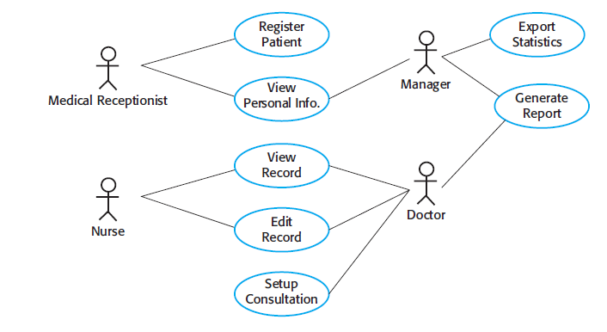
Use cases for the MHC-PMS

Slide 54
Requirements validation
Concerned with demonstrating that the requirements define the system that the customer really wants.
Requirements error costs are high so validation is very important
Fixing a requirements error after delivery may cost up to 100 times the cost of fixing an implementation error.

Slide 55
Requirements checking
Validity. Does the system provide the functions which best support the customer’s needs?
Consistency. Are there any requirements conflicts?
Completeness. Are all functions required by the customer included?
Realism. Can the requirements be implemented given available budget and technology
Verifiability. Can the requirements be checked?

Slide 56
Requirements validation techniques
Requirements reviews
Systematic manual analysis of the requirements.
Prototyping
Using an executable model of the system to check requirements. (Covered in Chapter 2.)
Test-case generation
Developing tests for requirements to check testability.

Slide 57
Requirements management
Requirements management is the process of managing changing requirements during the requirements engineering process and system development.
New requirements emerge as a system is being developed and after it has gone into use.

Slide 58
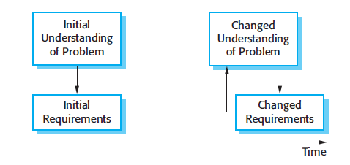
Requirements evolution

Slide 59
Requirements management planning
Establishes the level of requirements management detail that is required.
Requirements management decisions:
Requirements identification Each requirement must be uniquely identified so that it can be cross-referenced with other requirements.
A change management process This is the set of activities that assess the impact and cost of changes. I discuss this process in more detail in the following section.
Traceability policies These policies define the relationships between each requirement and between the requirements and the system design that should be recorded.
Tool support Tools that may be used range from specialist requirements management systems to spreadsheets and simple database systems.

Slide 60
Requirements change management
Deciding if a requirements change should be accepted
Problem analysis and change specification
During this stage, the problem or the change proposal is analyzed to check that it is valid. This analysis is fed back to the change requestor who may respond with a more specific requirements change proposal, or decide to withdraw the request.
Change analysis and costing
The effect of the proposed change is assessed using traceability information and general knowledge of the system requirements. Once this analysis is completed, a decision is made whether or not to proceed with the requirements change.
Change implementation
The requirements document and, where necessary, the system design and implementation, are modified. Ideally, the document should be organized so that changes can be easily implemented.

Slide 61
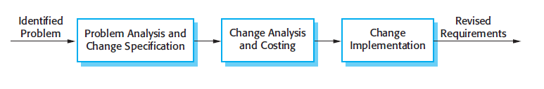
Requirements change management

Slide 62
Thank you !
Questions?

